Slide 1
R-Ladies London
Review 2016
library(dplyr)
r-ladies_global %>%
filter(city = 'london')

Slide 2
670
800
14
R-Ladies London Ladies
Twitter Followers @RLadiesLondon
2016 successful events

Slide 3
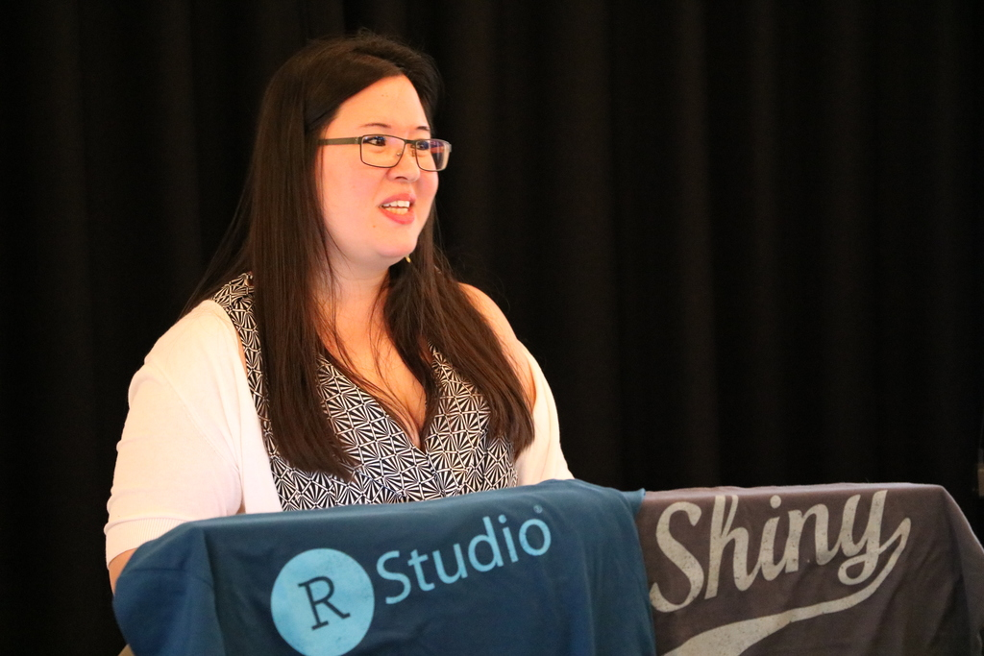
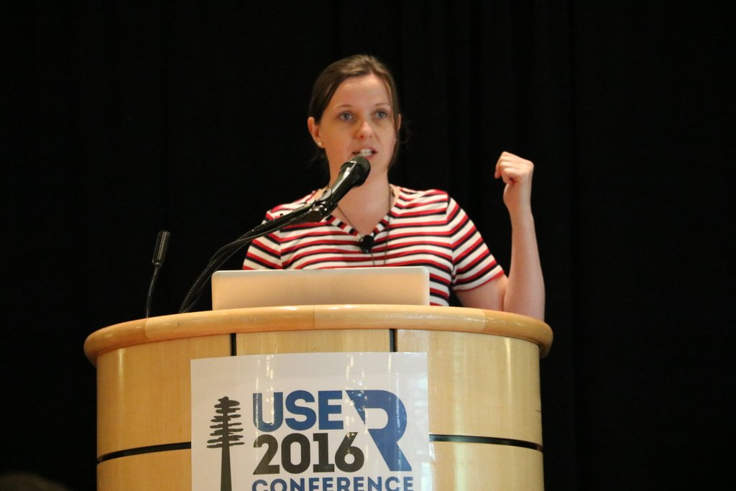
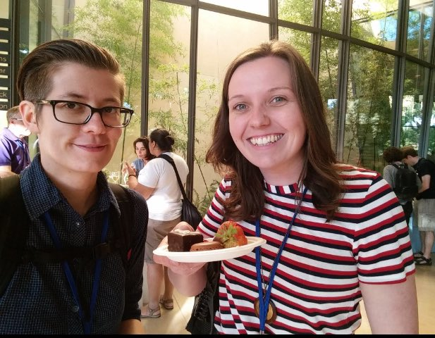
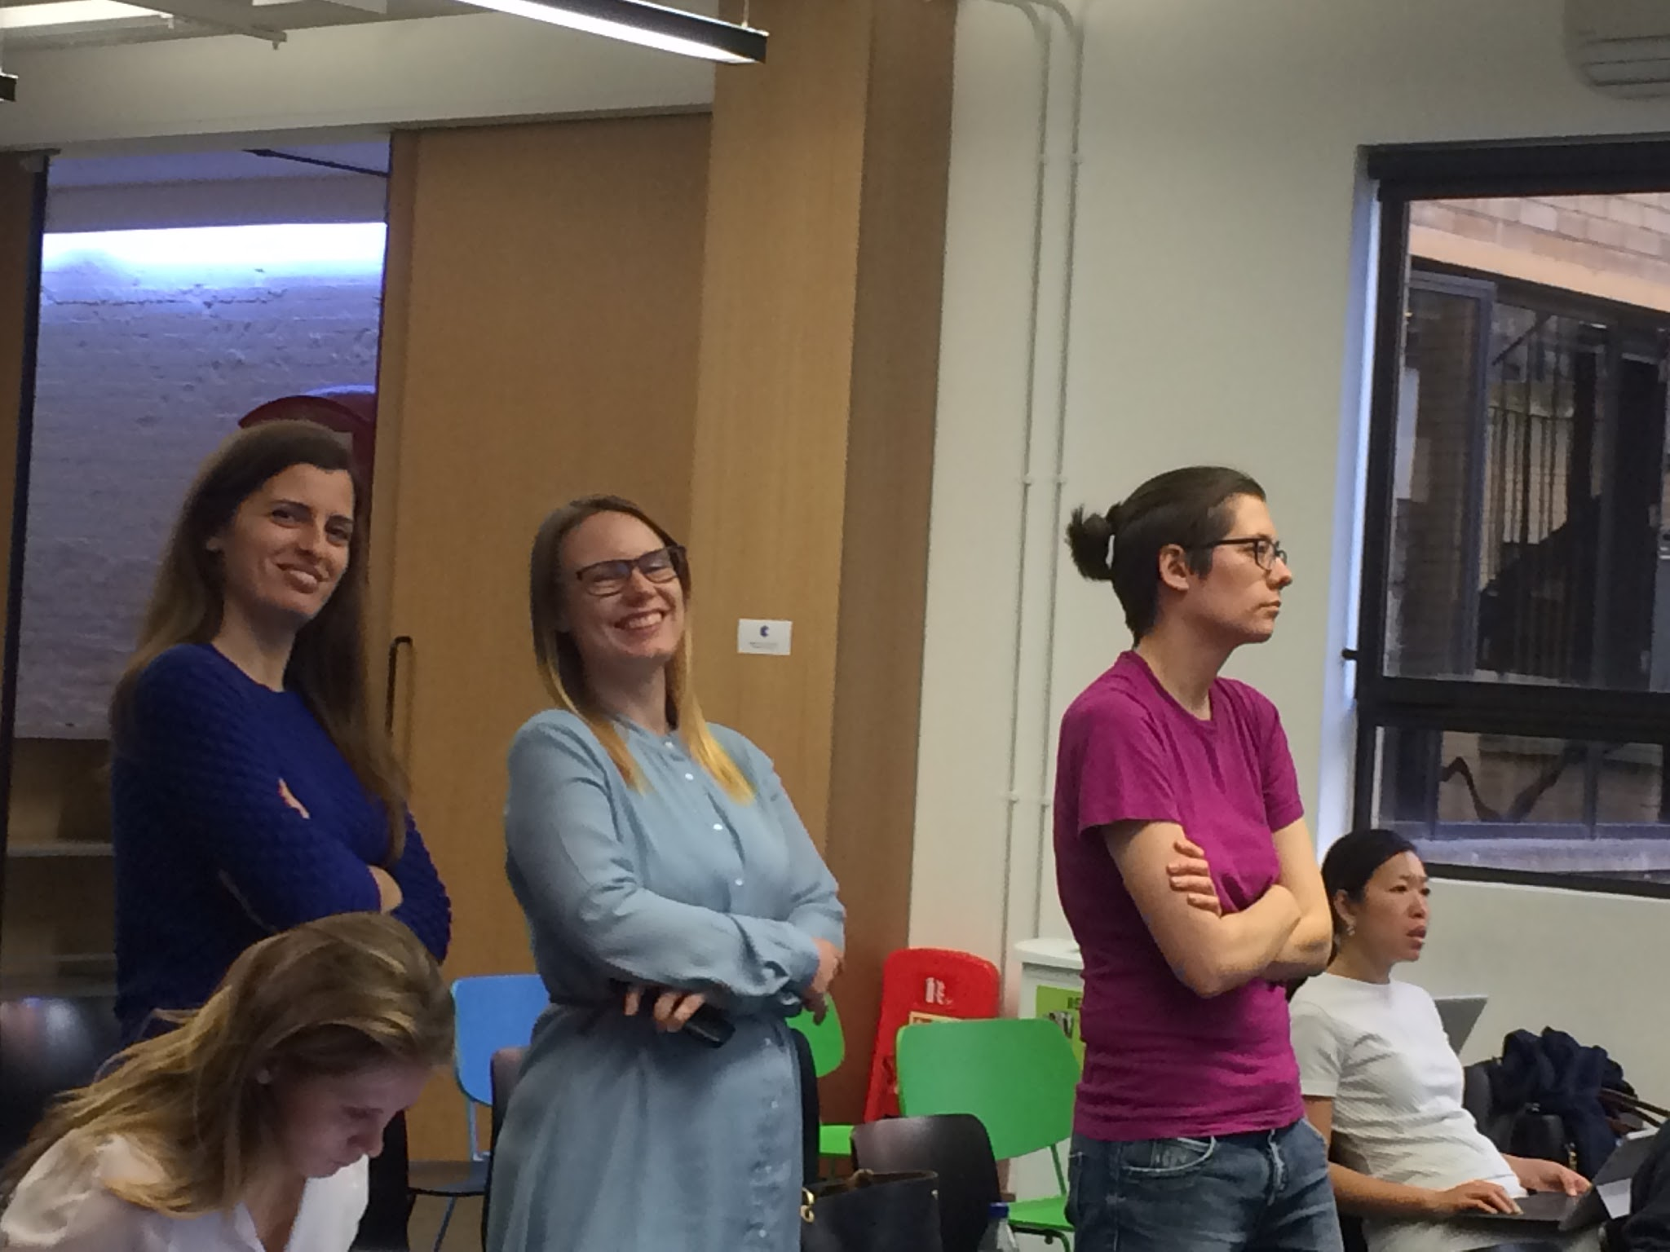
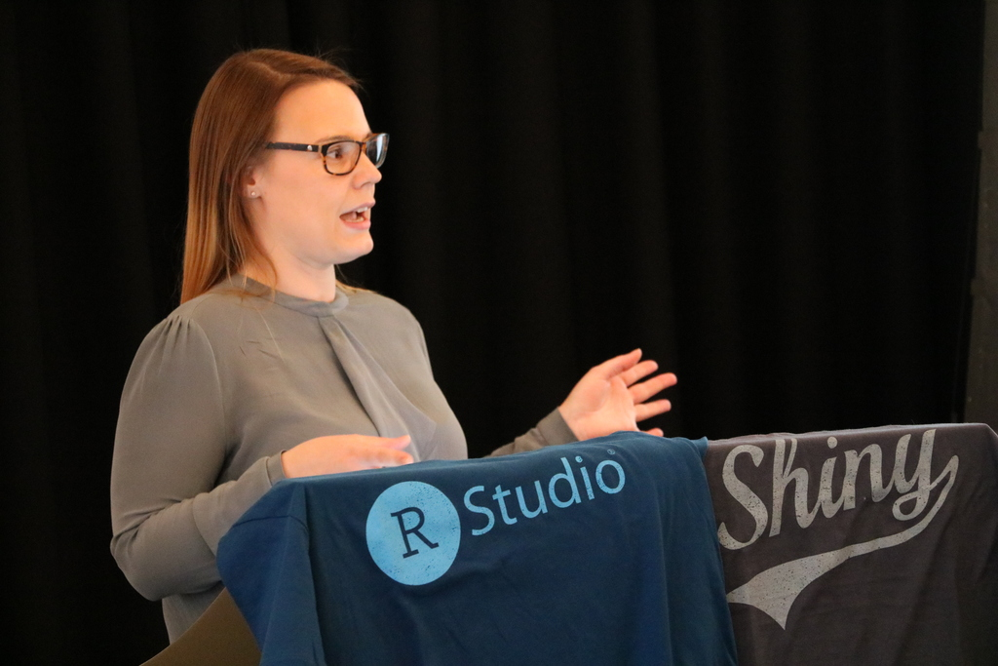
R-Ladies London Team
Chiin - Founder of R-Ladies London
Alice
Hannah
Claudia
Rachel
New mentors
Grace
Laura

Slide 4
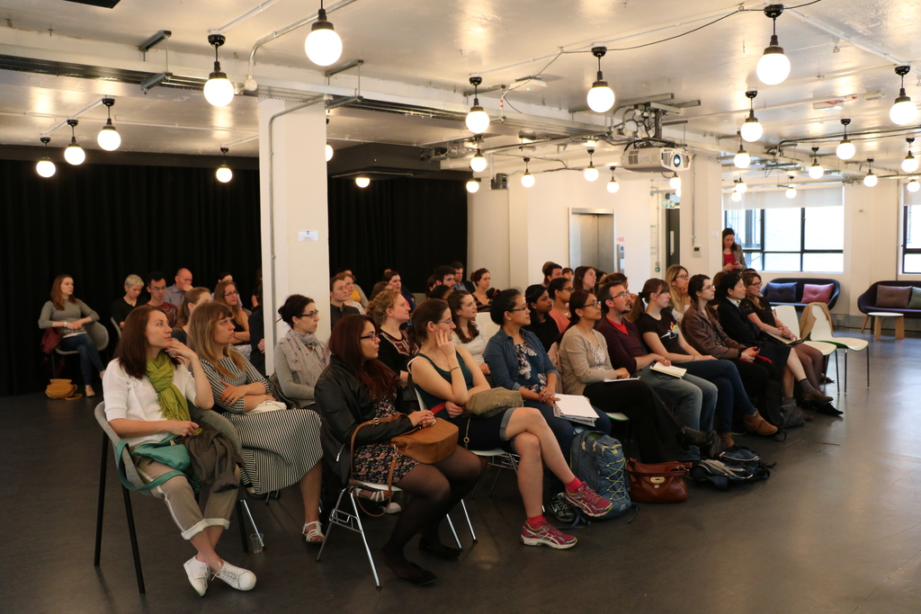
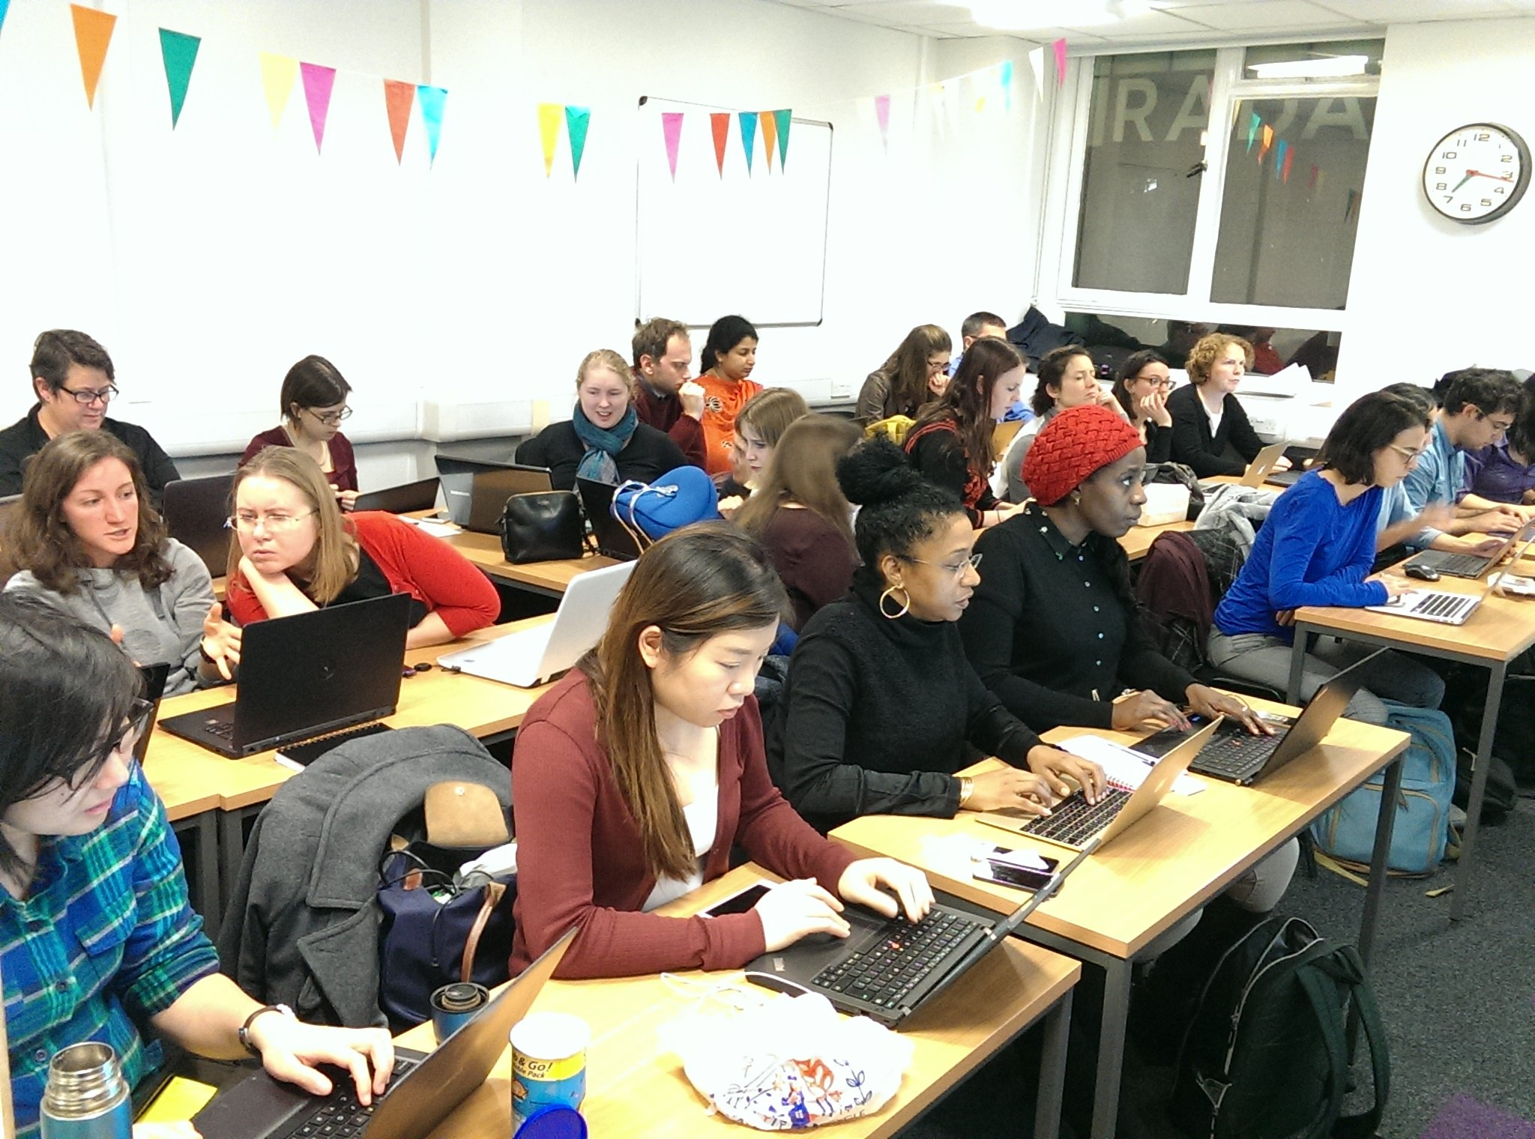
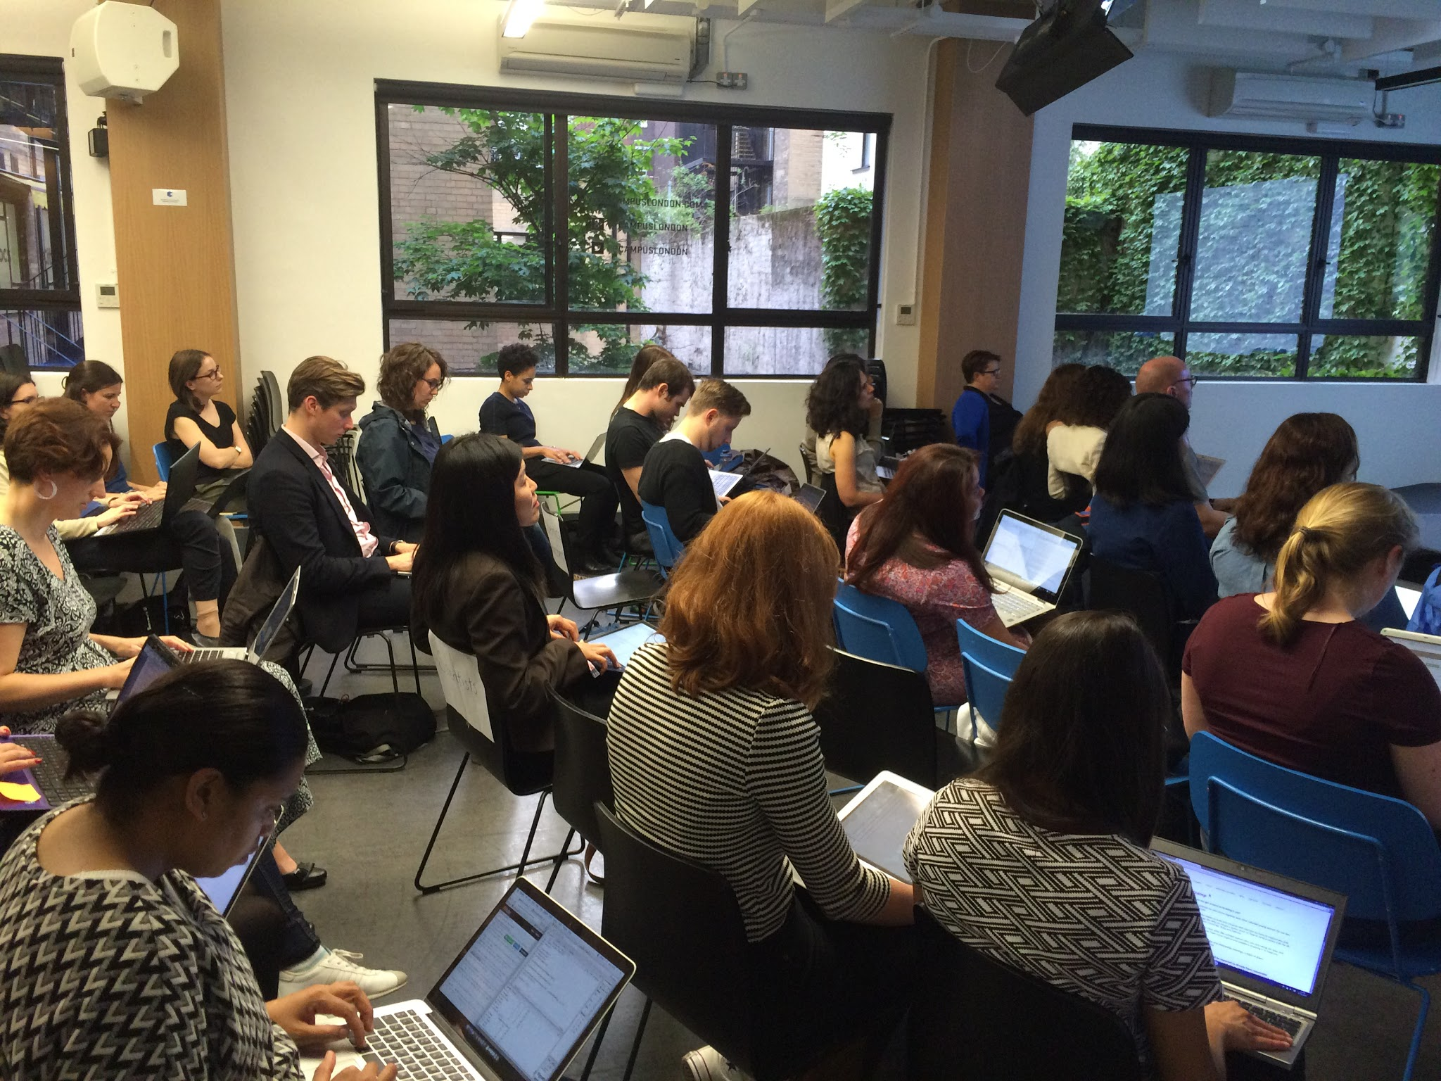
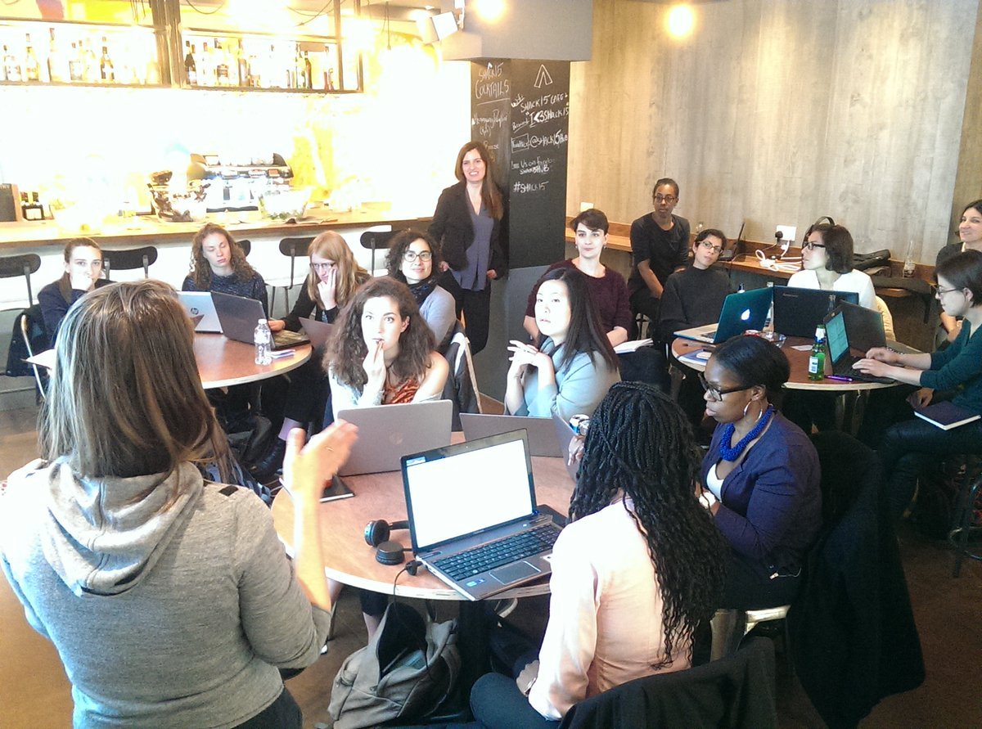
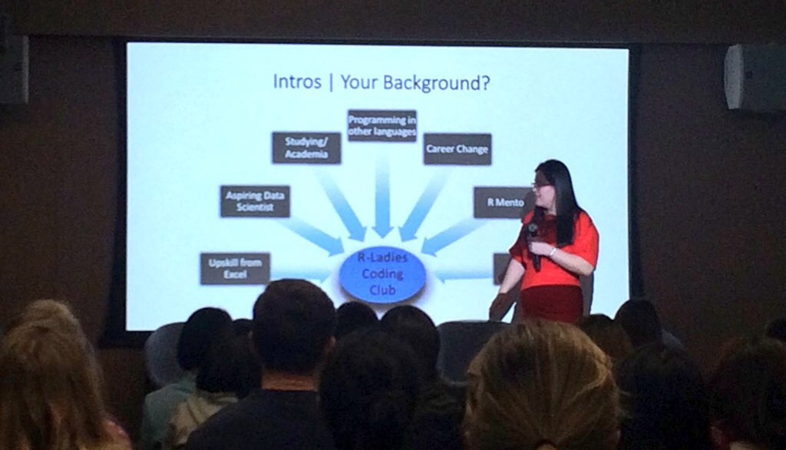
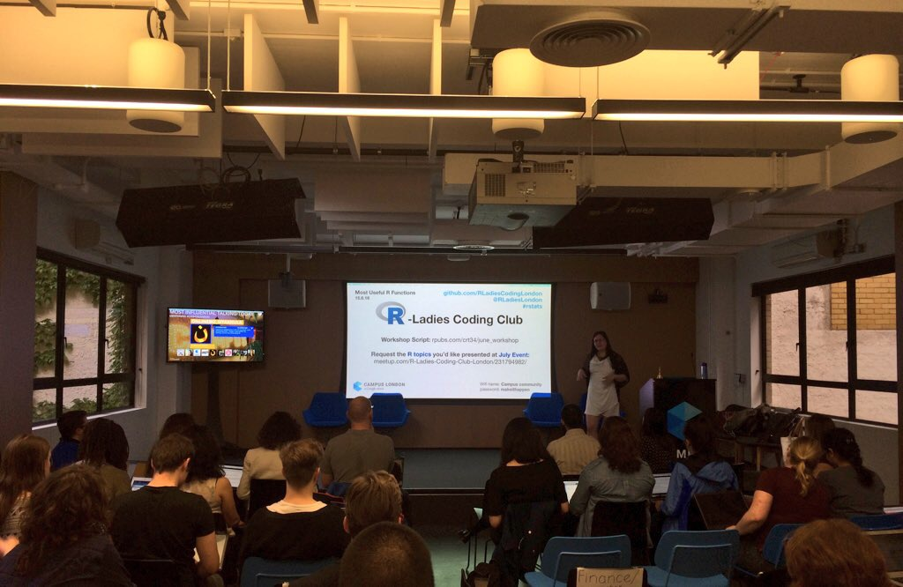
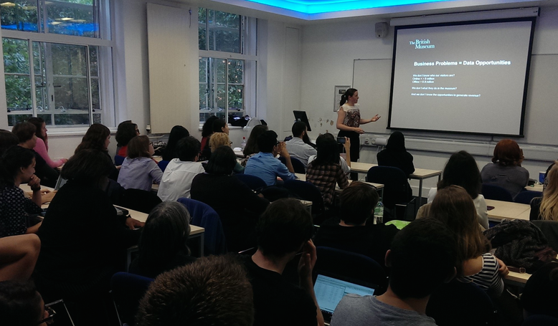
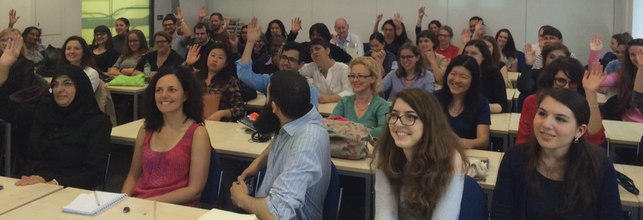
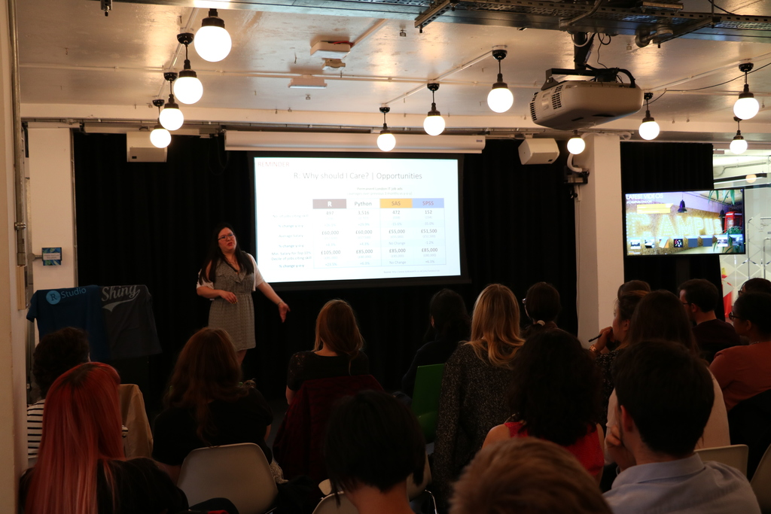
R-Ladies London Events

Slide 5
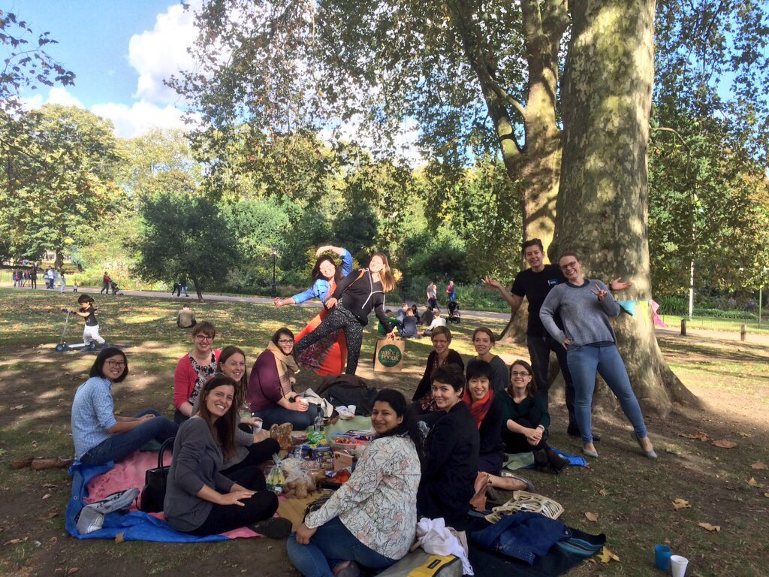
R-Ladies London
6 month birthday

Slide 6
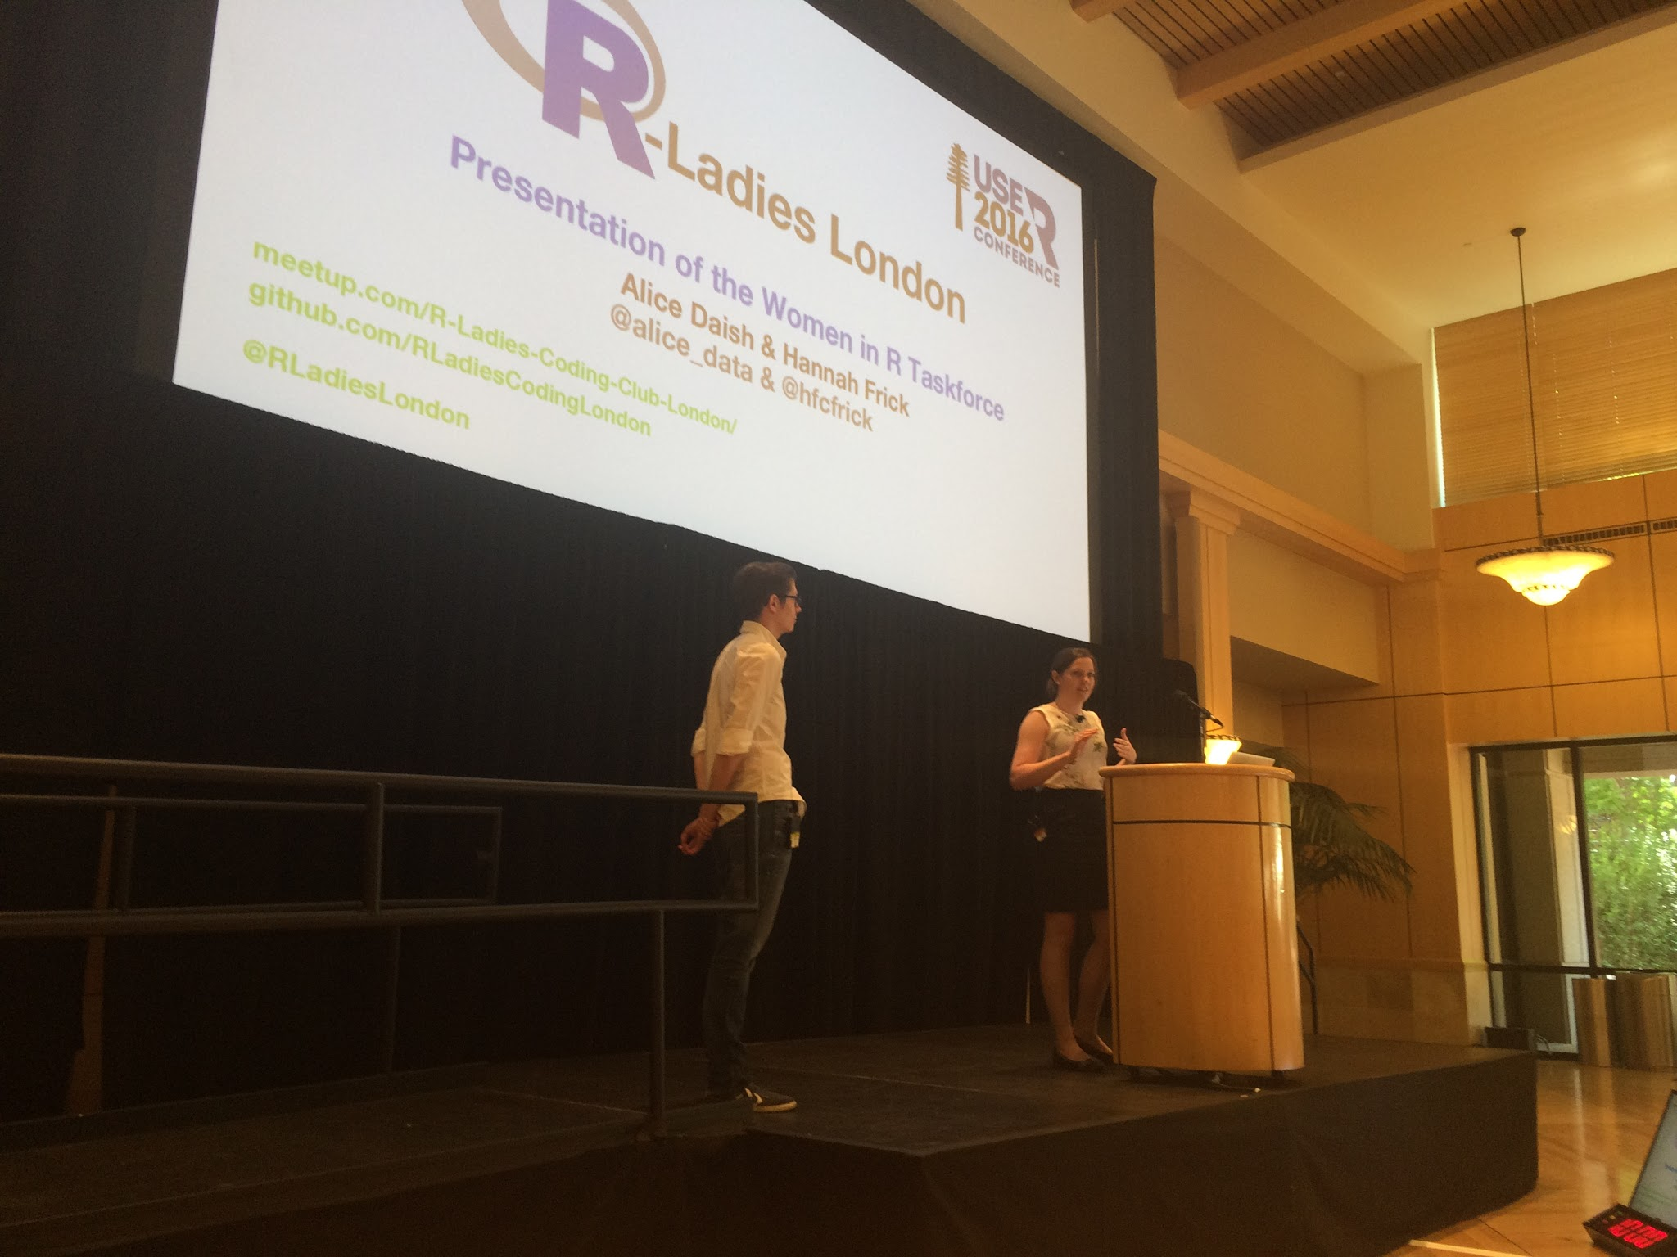
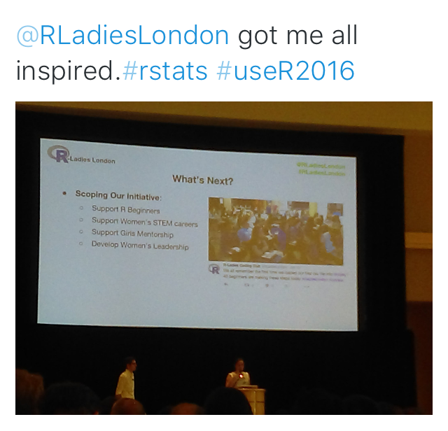
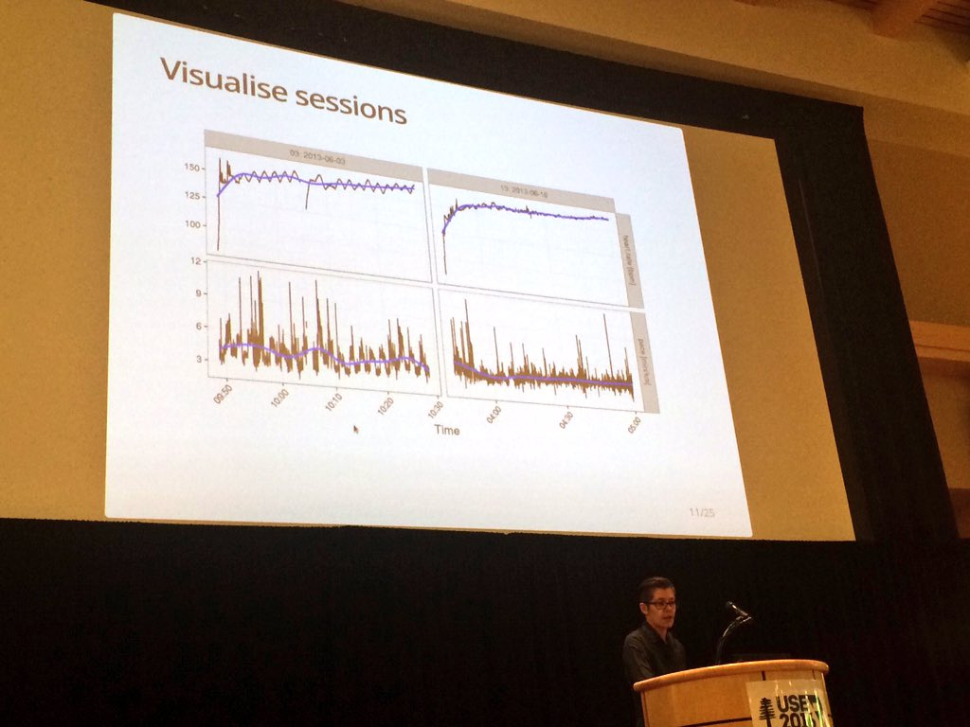
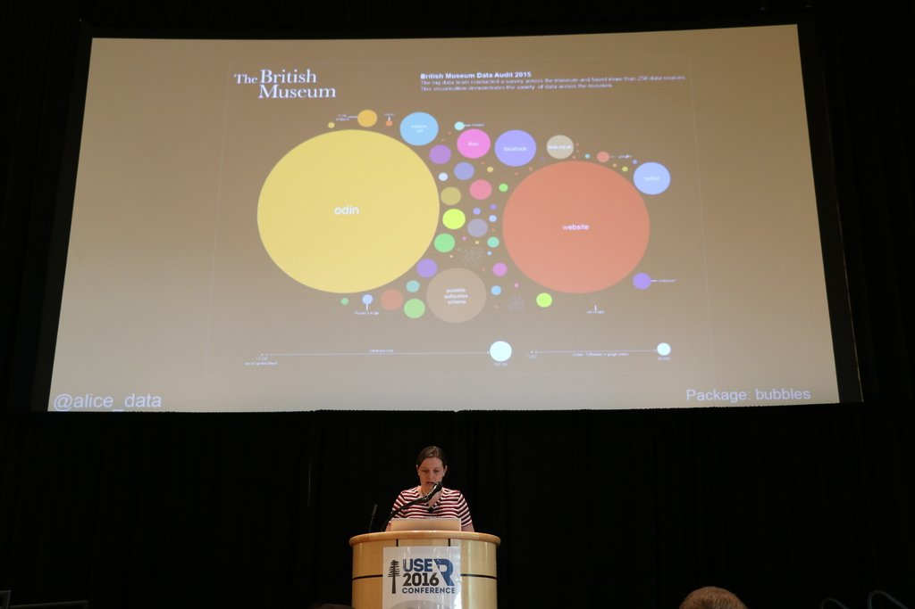
R-Ladies London @ useR 2016

Slide 7
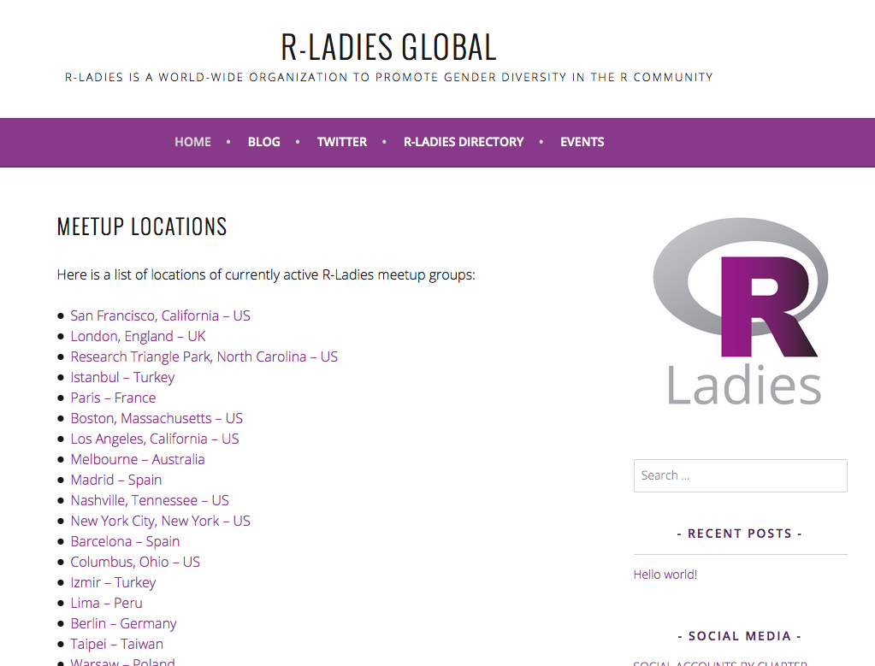
R-Ladies Global
Launched
3,000 R-Ladies in
25 cities &
you’re part of it!

Slide 8
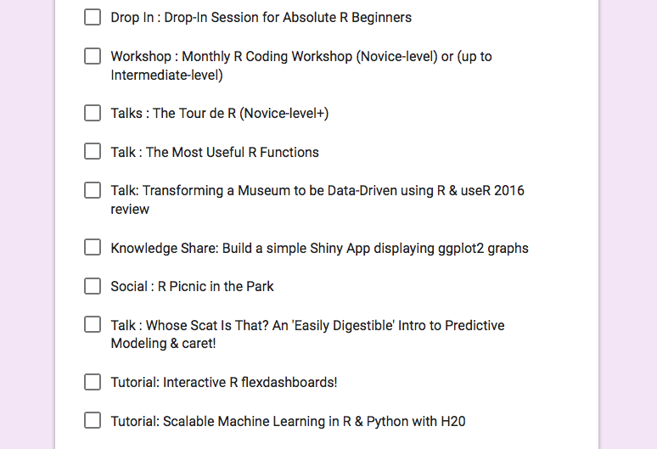
2016
2017
2016 Review
How did 2016 go for R-Ladies London?
2017 Planning
Look forward to the awesome
R-Ladies London activities in 2017.

Slide 9
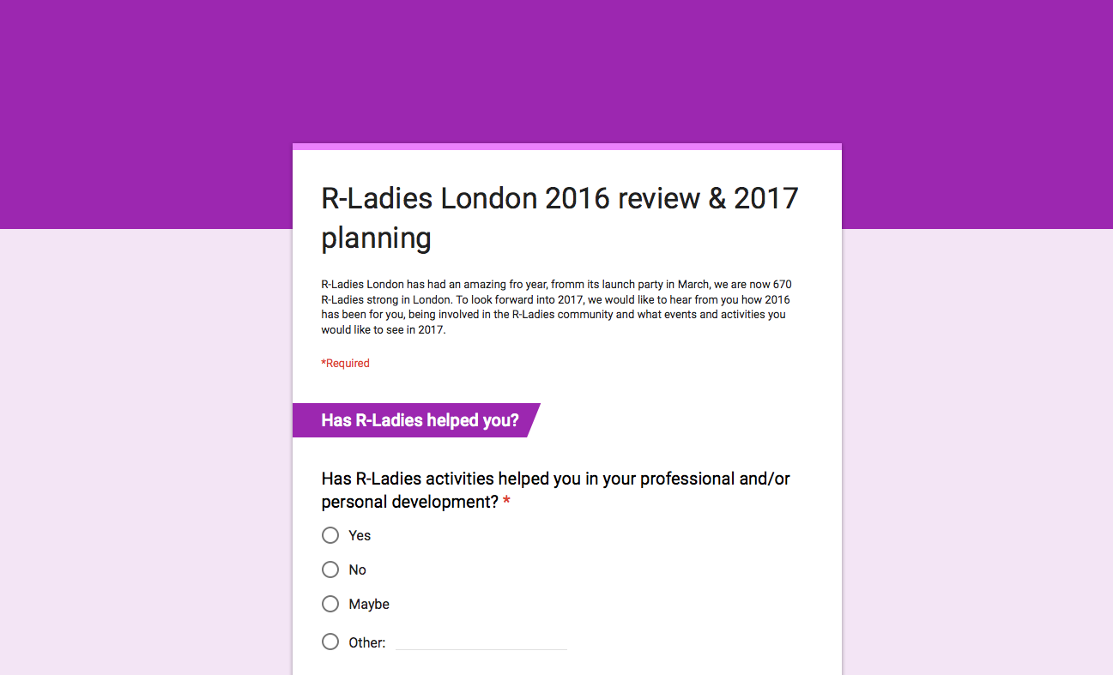
Have your Say ....
https://goo.gl/forms/iORjh4fVjm741zHL2
Notes:
Hand out -

